Slide 1
Multi-Threading
-Susan Lama

Slide 2
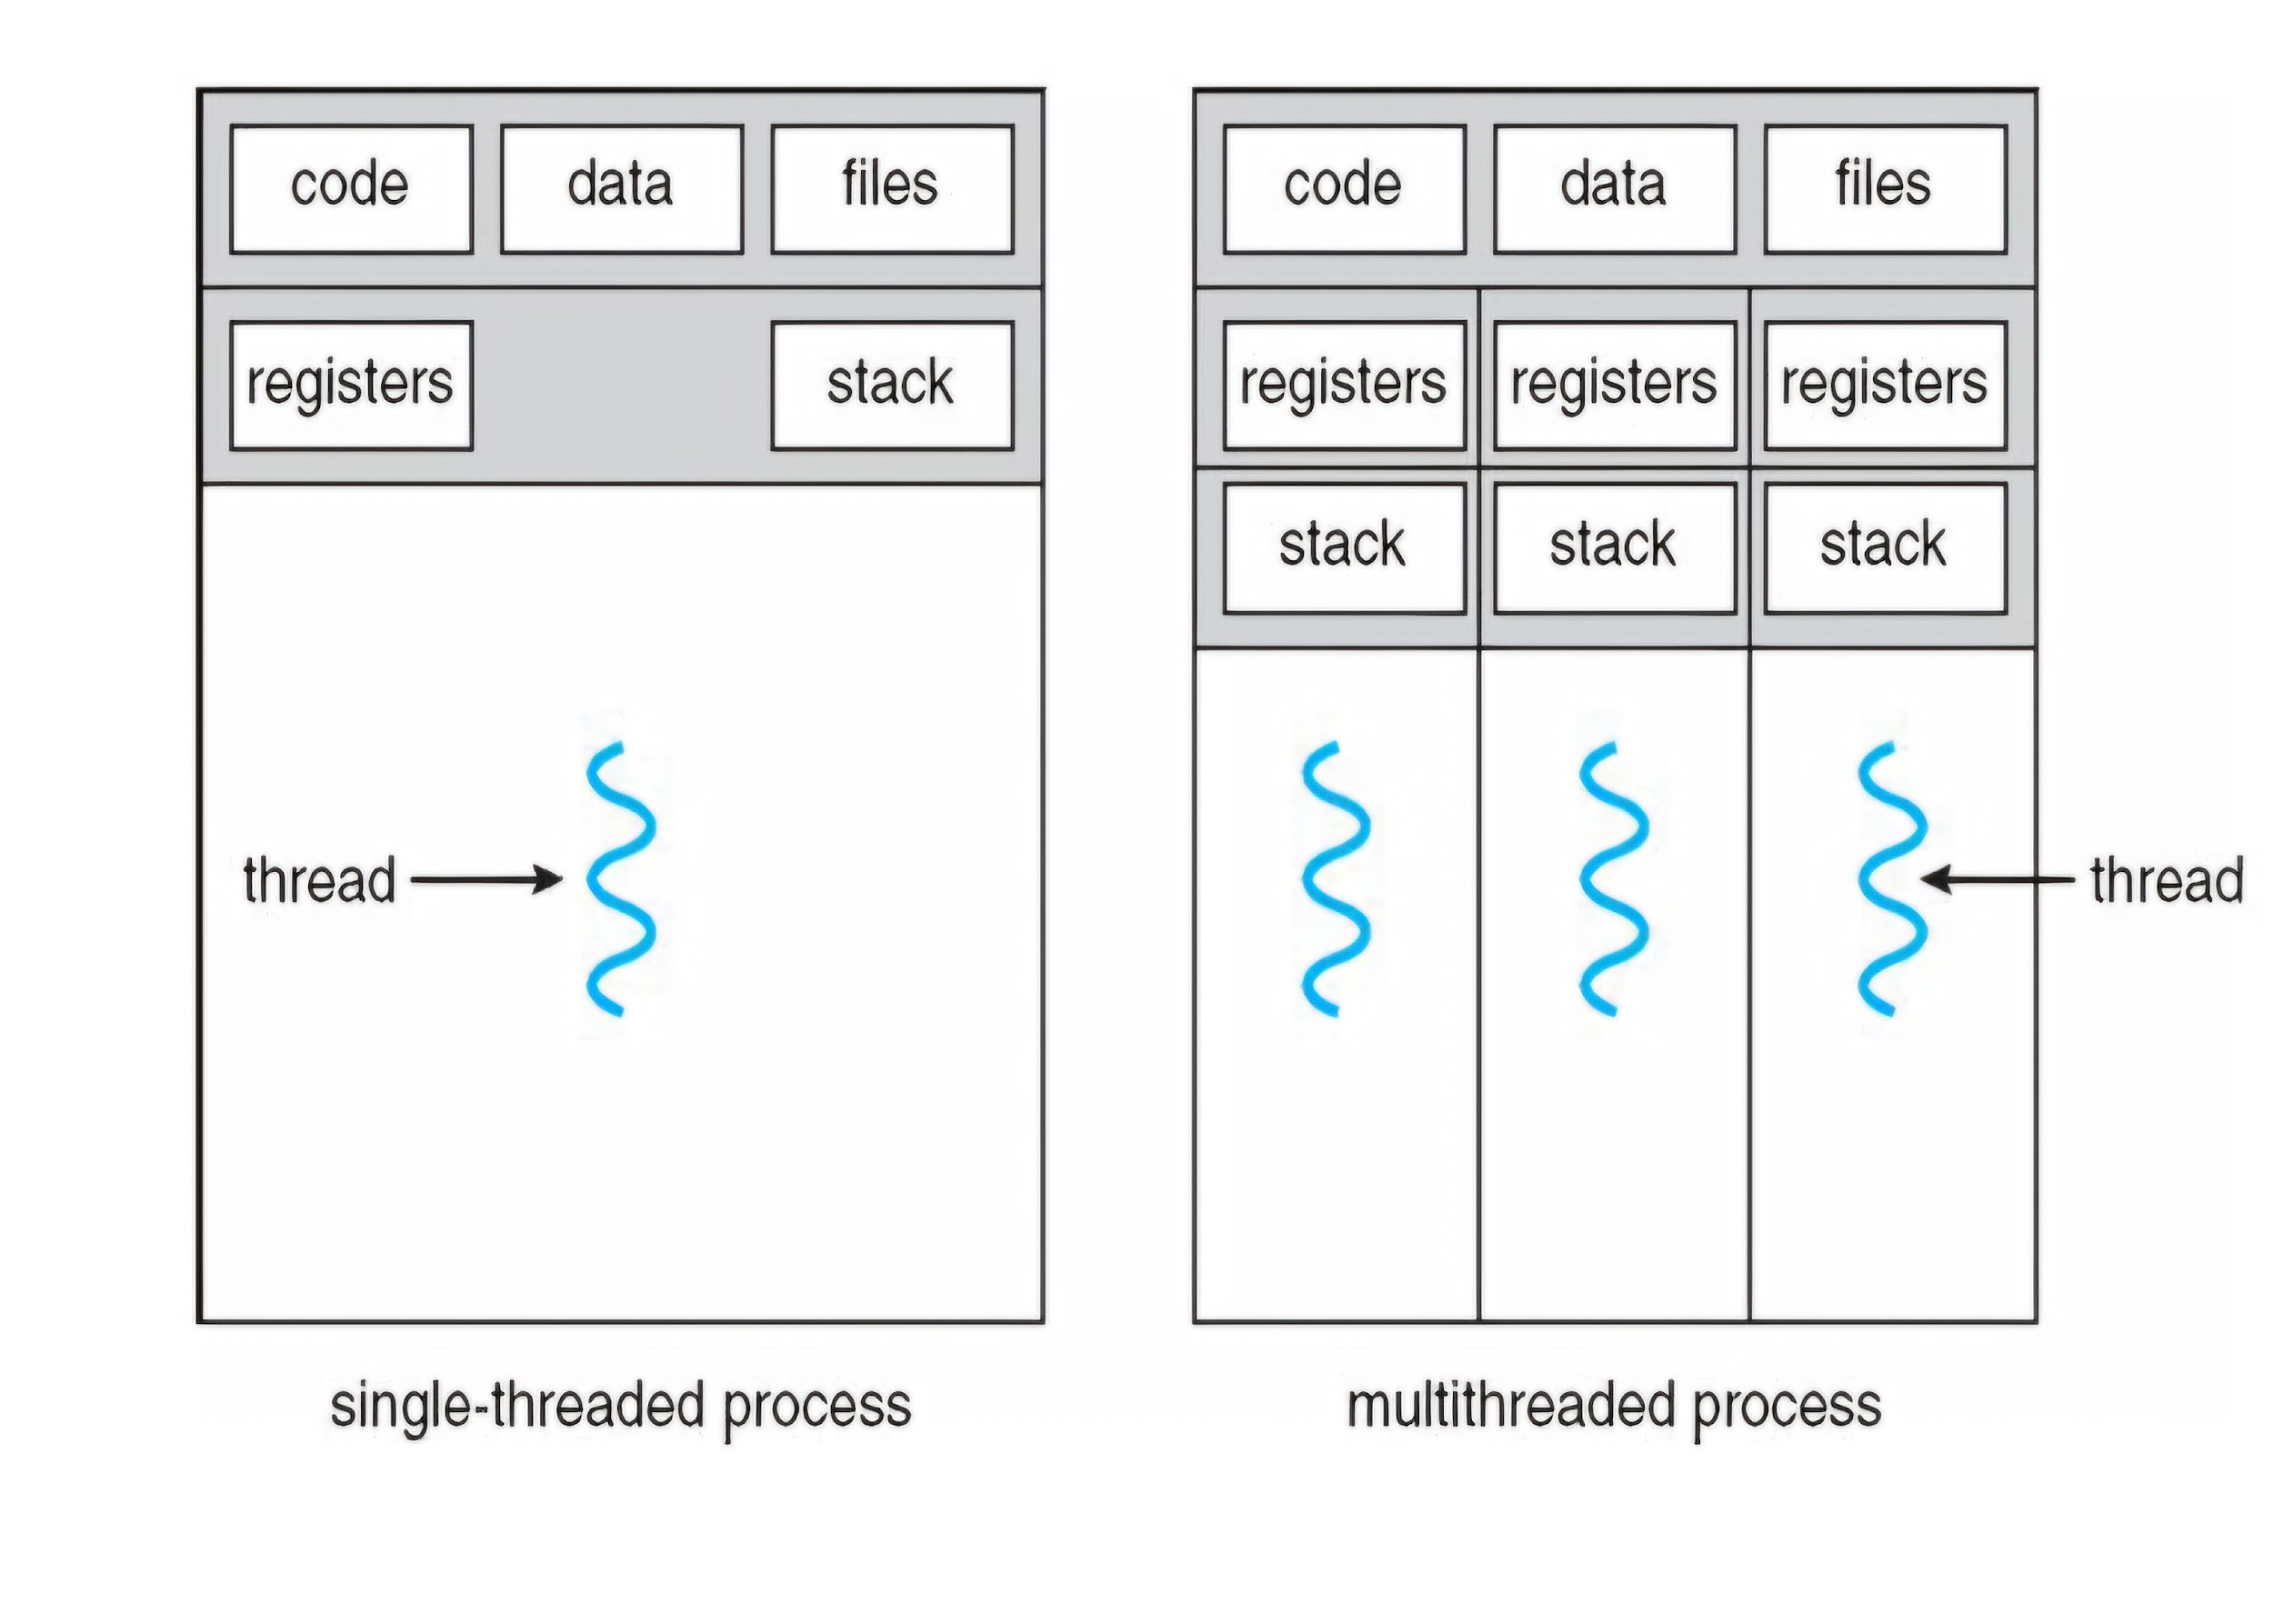
Program = Set of instructions.
Process = Program in execution, doing the actual task.
Thread = Small tasks or units of execution within a process, performing parts of the larger task.

Slide 3
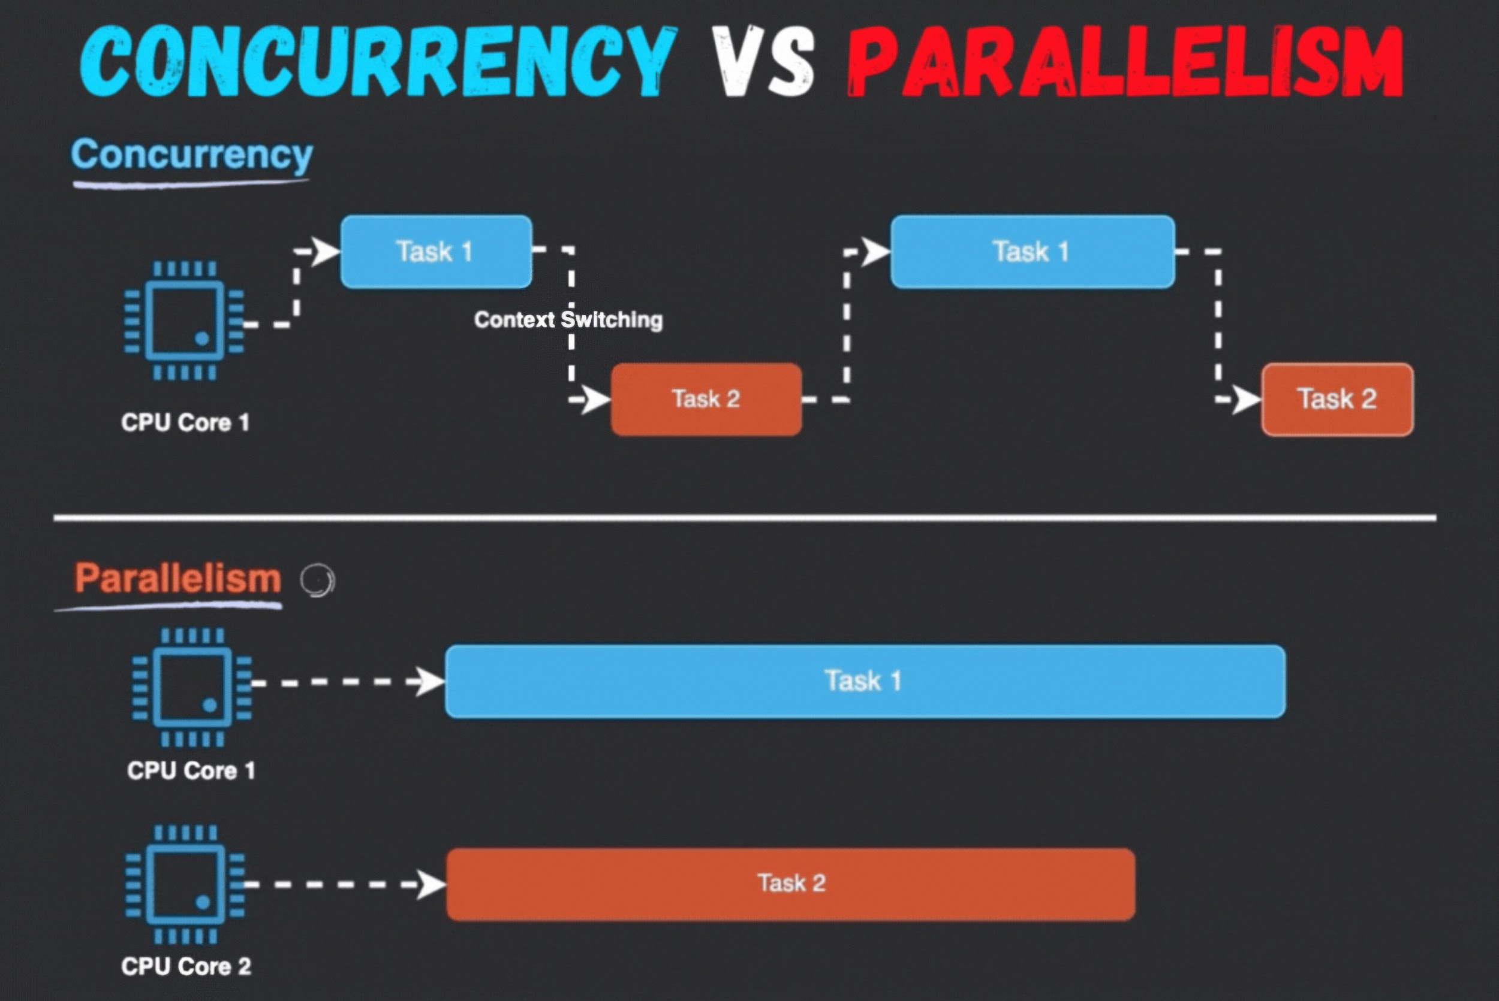

Slide 4
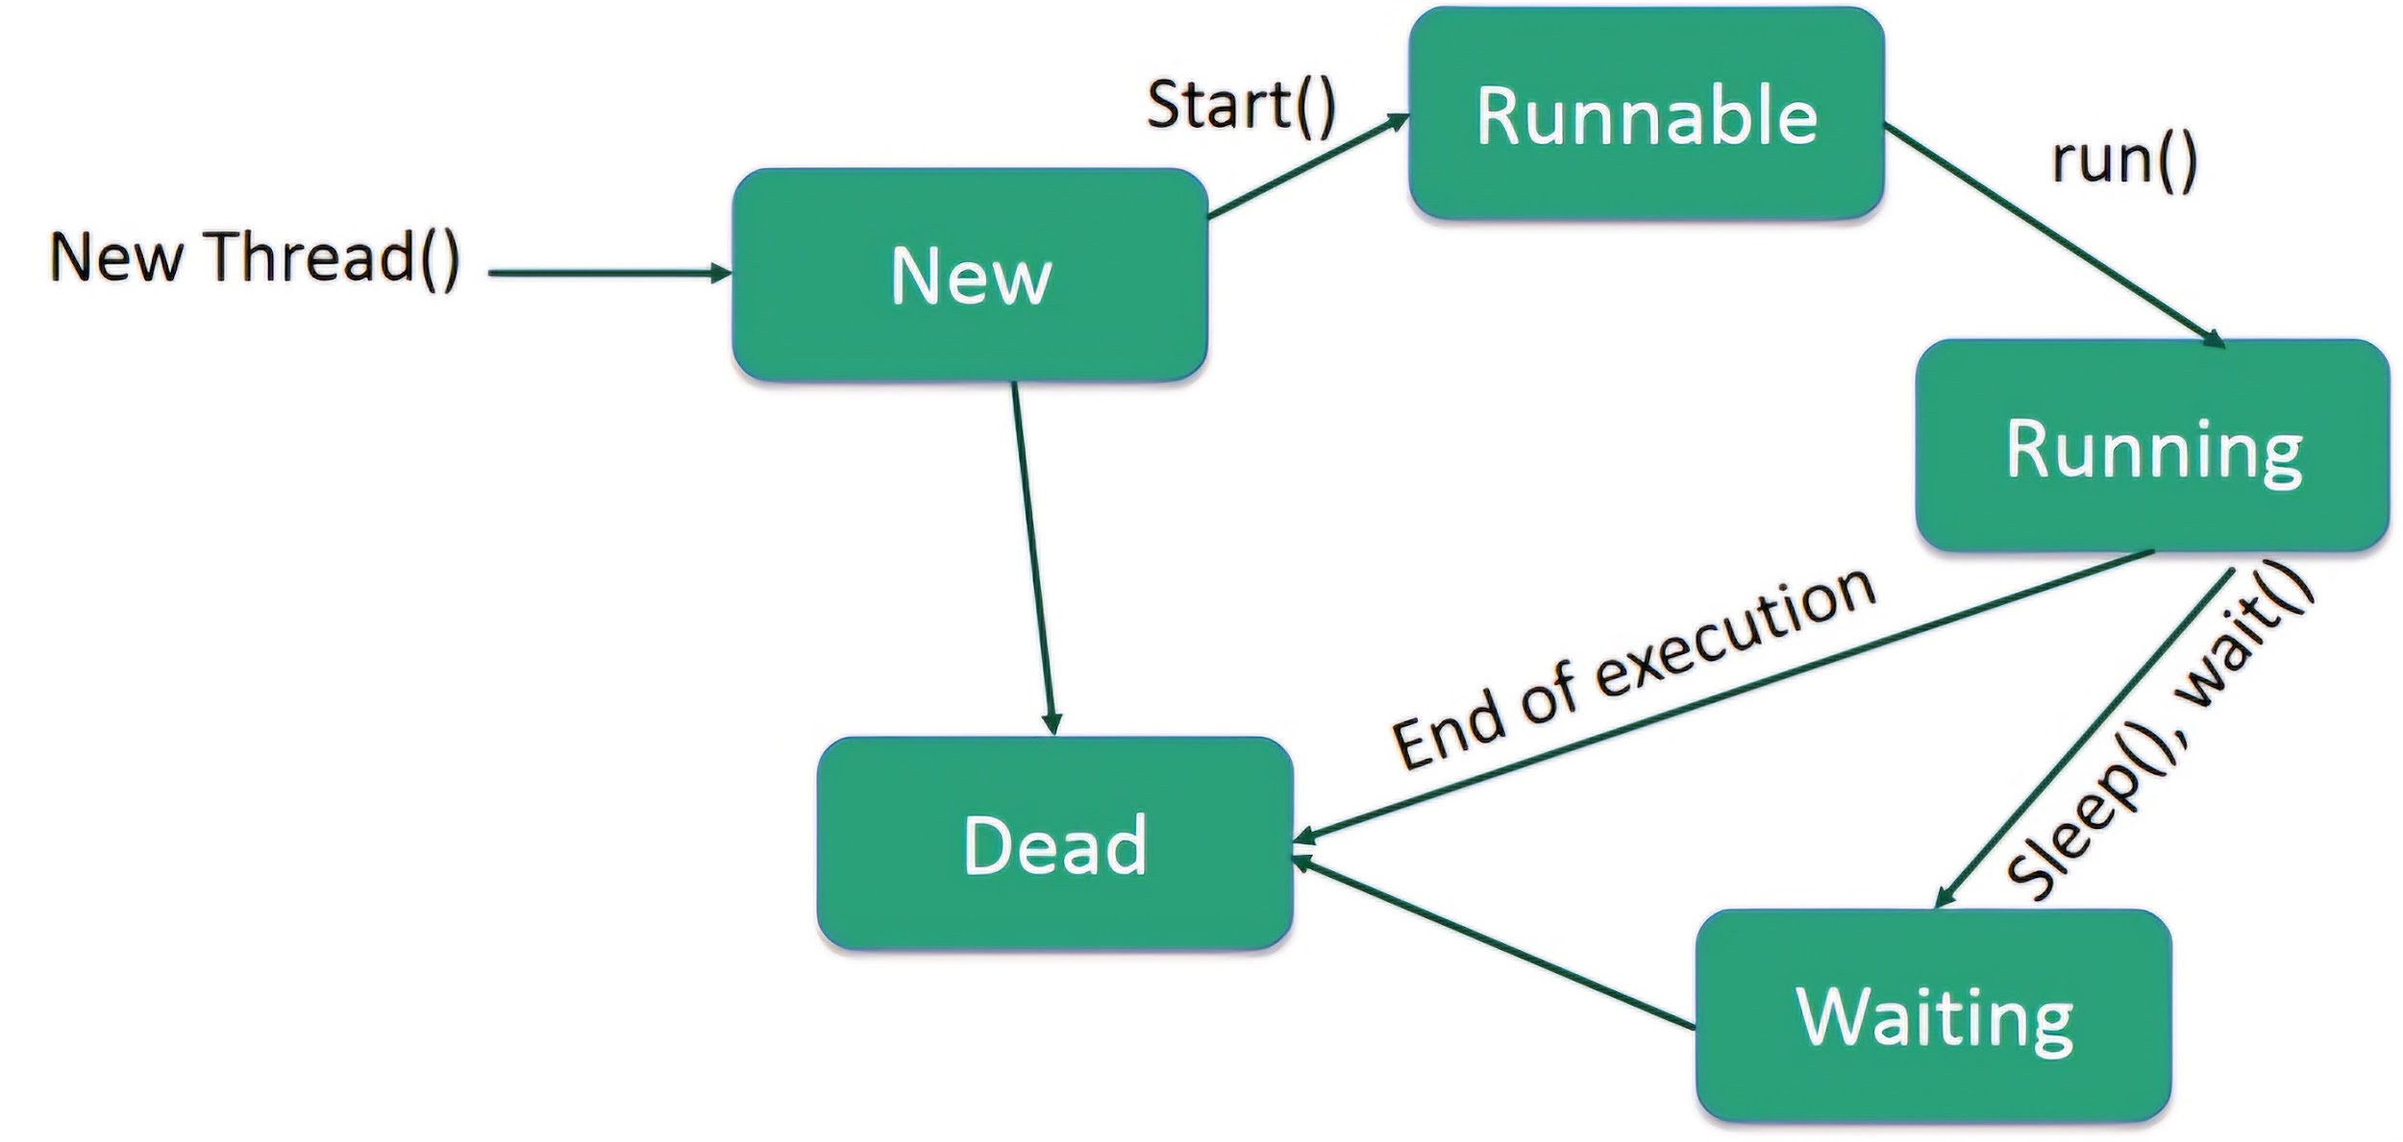
Fig: Life-Cycle of Thread

Slide 5
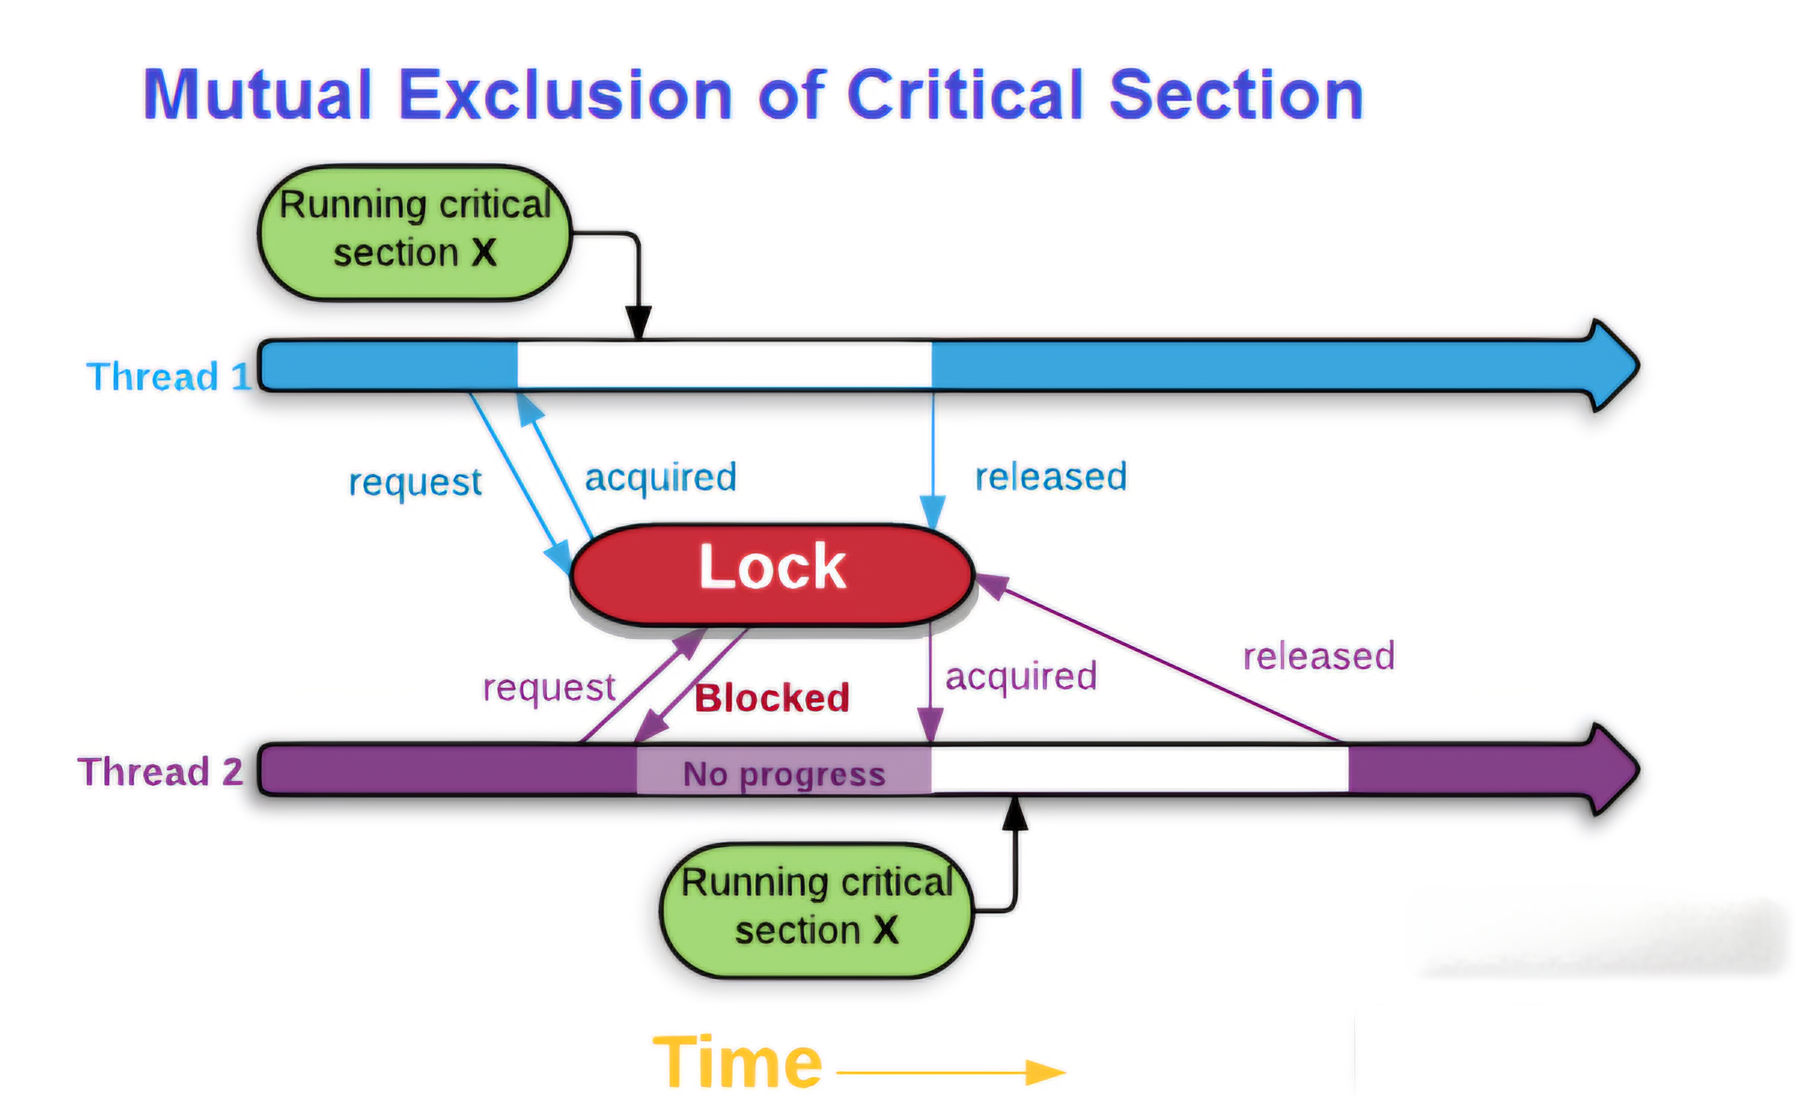

Slide 6
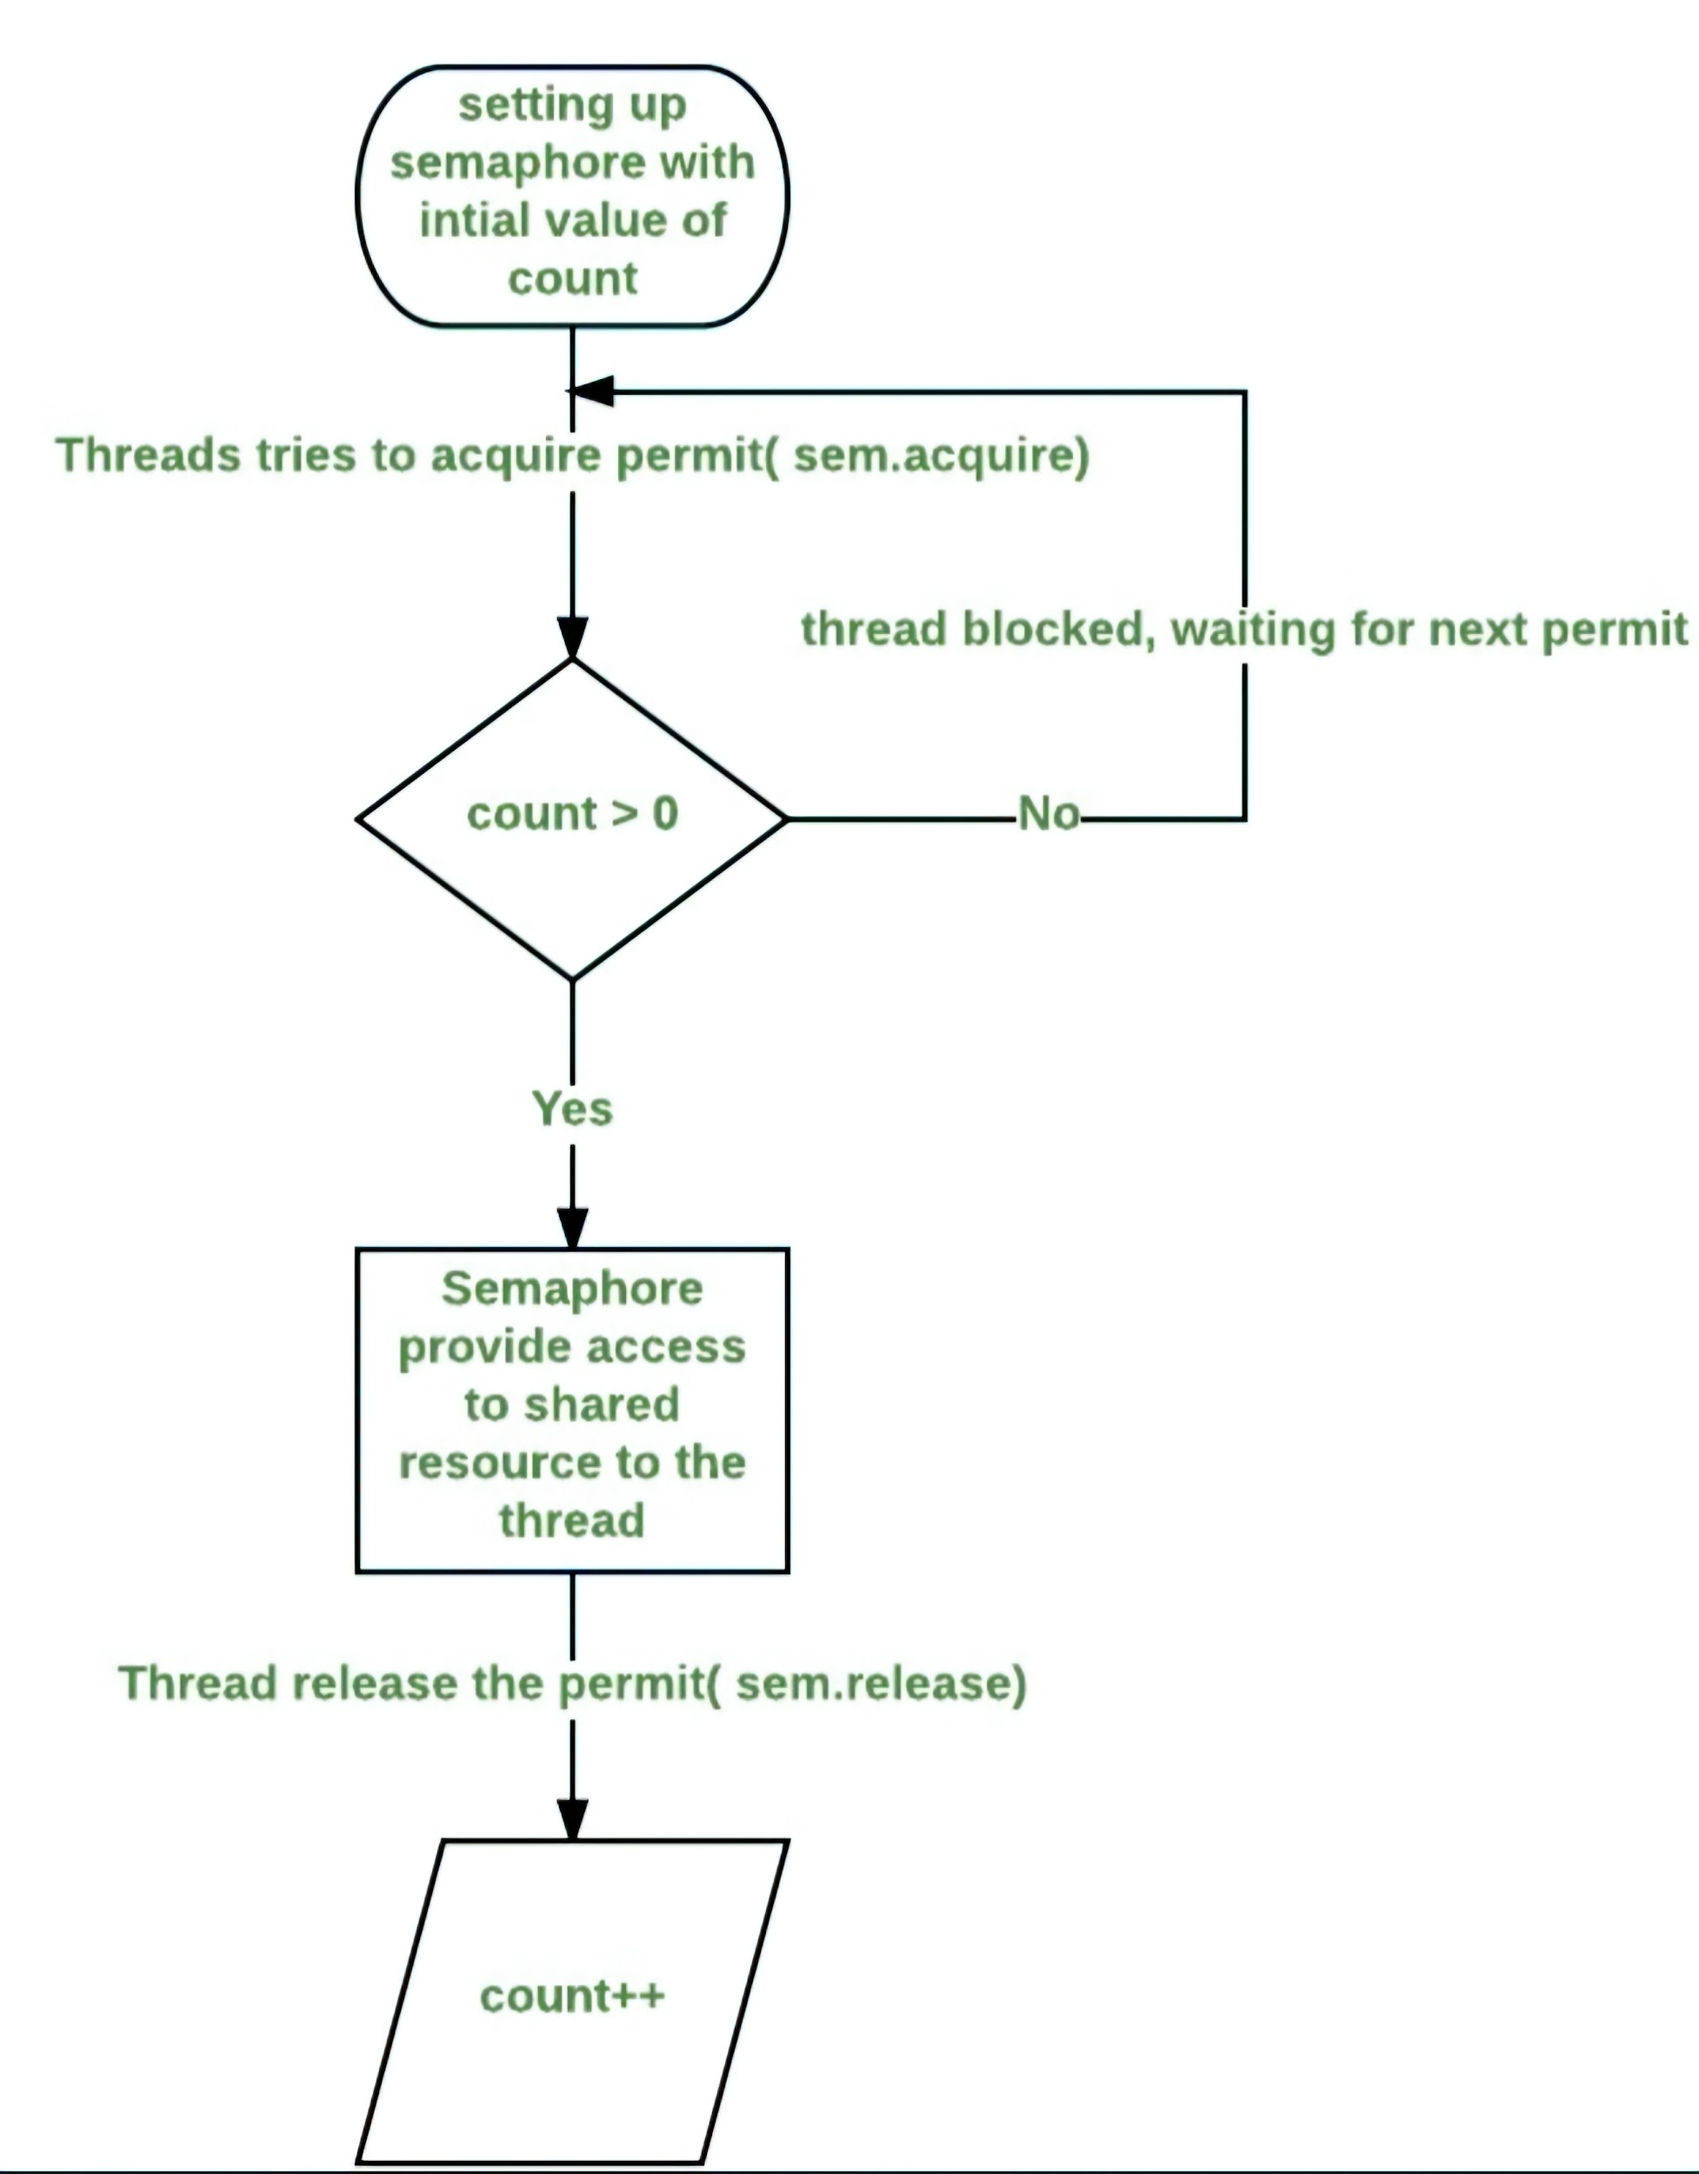
Fig: Working of Semaphore

Slide 7
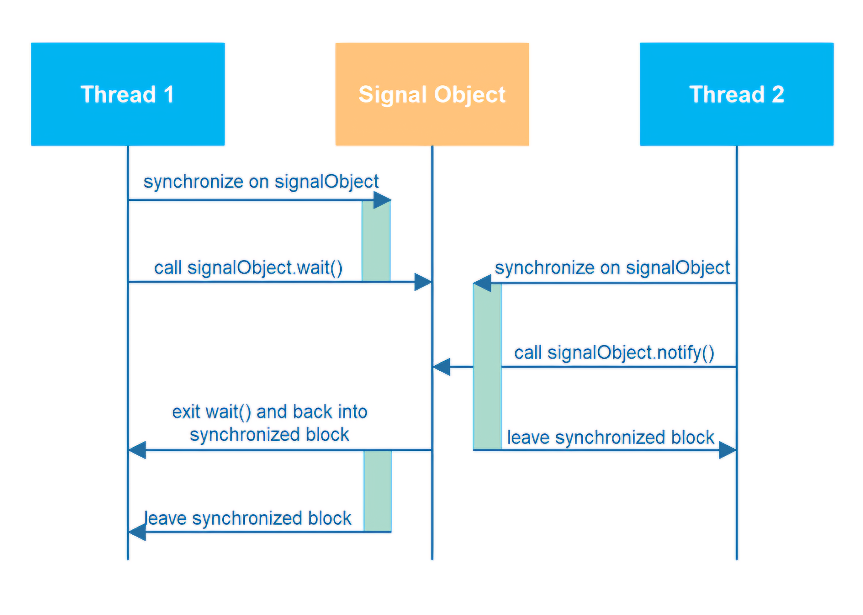
Fig: Thread Signaling

Slide 8
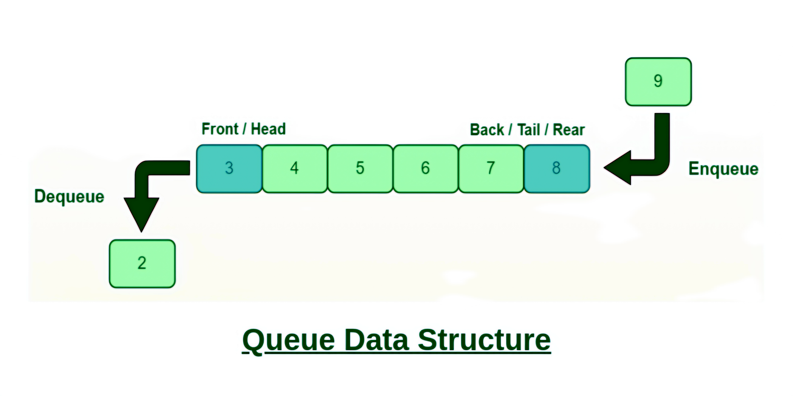

Slide 9
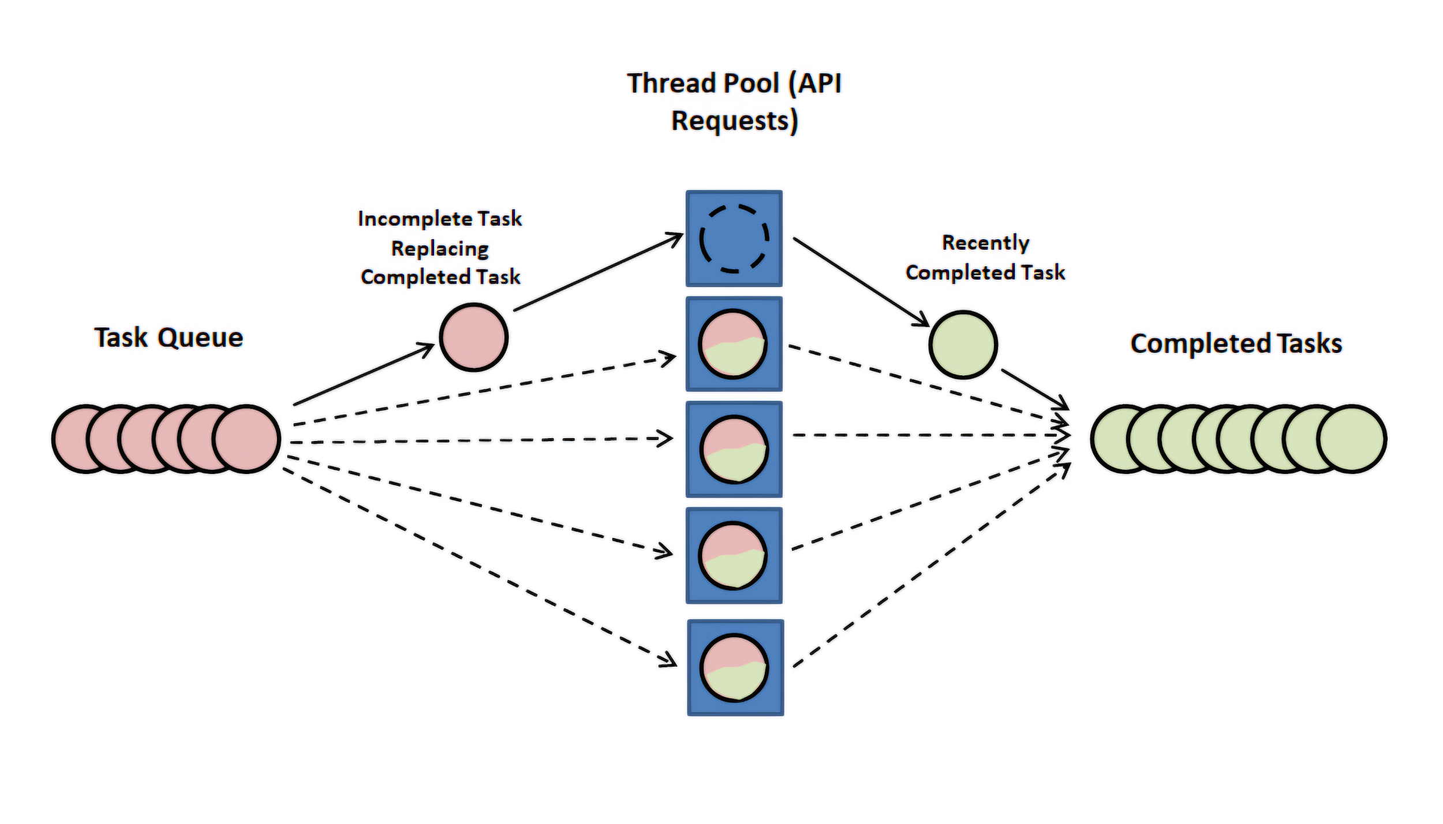
Fig: Thread Pool

Slide 10
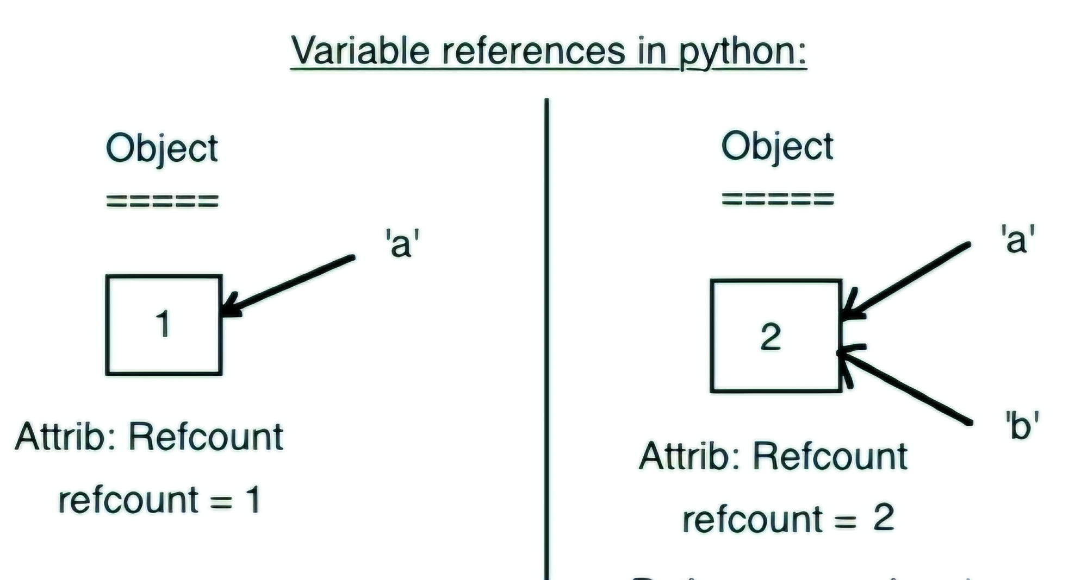

Slide 11
References:
MultiThreading- Documentation
https://superfastpython.com/threading-in-python/
Youtube- Code-yug
Youtube- codebasics

Slide 12
Thank You

